Slide 1

DEPOSITION WELDING
SIMULATION
Research Project - I (ME071601)
Department of Mechanical Engineering
National Institute Of Technology Patna
September 2026
Presented By:
SHARANSH (2301090)
GAURAV KUMAR(2301089)
AKANKSHA SHARMA (2301093)
Supervised By:
Dr. Yogesh Kumar

Slide 2
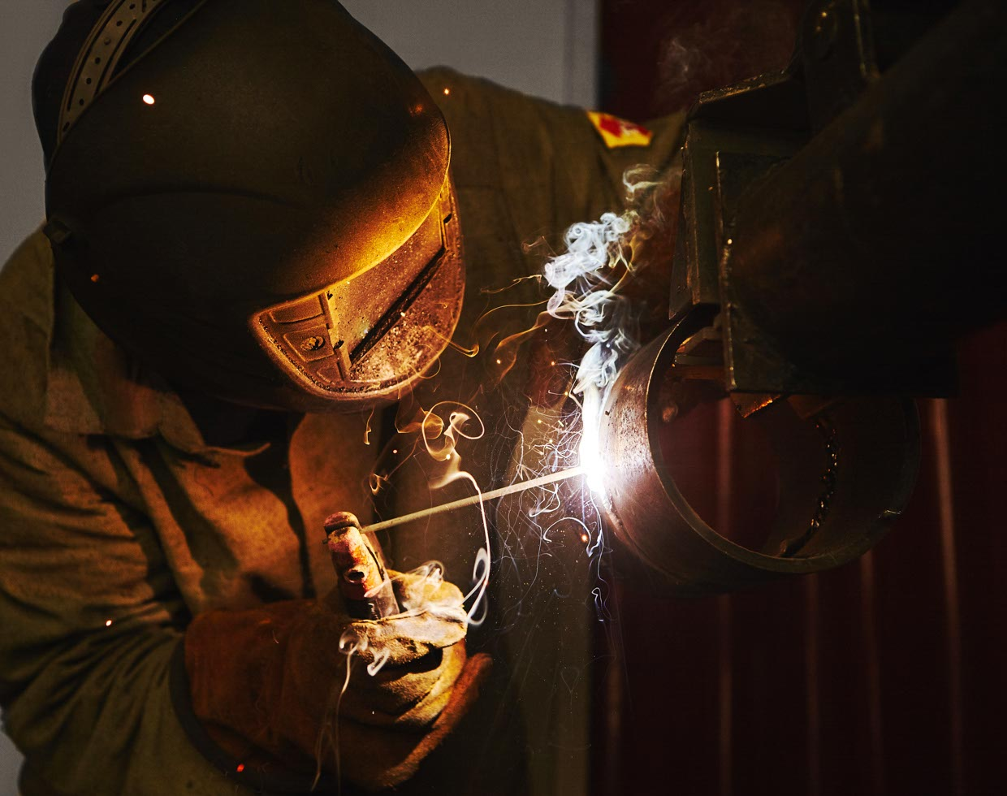
AIM - To simulate the Deposition process, and study its thermal and mechanical behaviour, during multi-layer material deposition.
What is Deposition Welding?
PROCESS SEQUENCE
Deposition welding is a process in which material is melted and deposited onto a base material, building up a new layer or restoring an existing component.
Heat Source
▾
Melting
▾
Material Deposition
▾
Solidification
▾
New Layer
Notes:
Let's start with the basic idea. Deposition welding simply means melting a material and depositing it onto a base component to add a new layer, either to build up geometry or to repair a worn part. The important elements are the substrate, which is the base component; the heat source, which melts the filler material; the molten pool that forms; and finally the solidified layer that remains once it cools. This is repeated layer after layer until the required shape is achieved. On the right you can see the basic sequence: heat source, melting, deposition, solidification, and finally a new layer of material.

Slide 3
How Deposition Welding Works ?
1
Substrate is prepared (cleaned, positioned, fixtured)
4
Molten material cools and solidifies
2
Heat source generates sufficient heat to melt the deposition material
5
Heat source moves along the predefined path
3
Molten material is deposited onto the substrate
6
Additional layers are deposited to build the required geometry
Substrate
Heat + Filler
Molten Pool
Solidification
Layer 1
Layer 2
Final Part
▸
▸
▸
▸
▸
▸
Notes:
This slide breaks the process into six simple steps. First, the substrate is prepared — cleaned and fixed in position. Second, the heat source generates enough heat to melt the filler material. Third, this molten material is deposited onto the substrate. Fourth, it cools and solidifies into a bonded layer. Fifth, the heat source keeps moving along a predefined path, and sixth, more layers are added on top until we reach the final geometry. The strip at the bottom summarizes this as one continuous flow, from the bare substrate all the way to the final deposited component.

Slide 4
Why Do We Need Simulation?
Without Simulation | With Simulation
More trial-and-error | Reduced trial-and-error
Higher experimental cost | Lower development cost
Difficult to predict distortion | Distortion can be predicted
Difficult to study thermal history | Temperature history available
More physical testing | Fewer physical trials
Notes:
Here's the real problem with actual welding. It generates very high, localized temperatures, which means the material heats up, expands, then cools and contracts. Because this heating and cooling is never perfectly uniform, it produces temperature gradients, residual stresses, distortion, dimensional inaccuracies, and sometimes defects. Simulation lets us predict all of this before we ever manufacture the actual component. The table summarizes the benefit clearly — without simulation we rely heavily on trial and error and physical testing, but with simulation we can predict distortion and thermal history in advance, which reduces cost and testing.

Slide 5
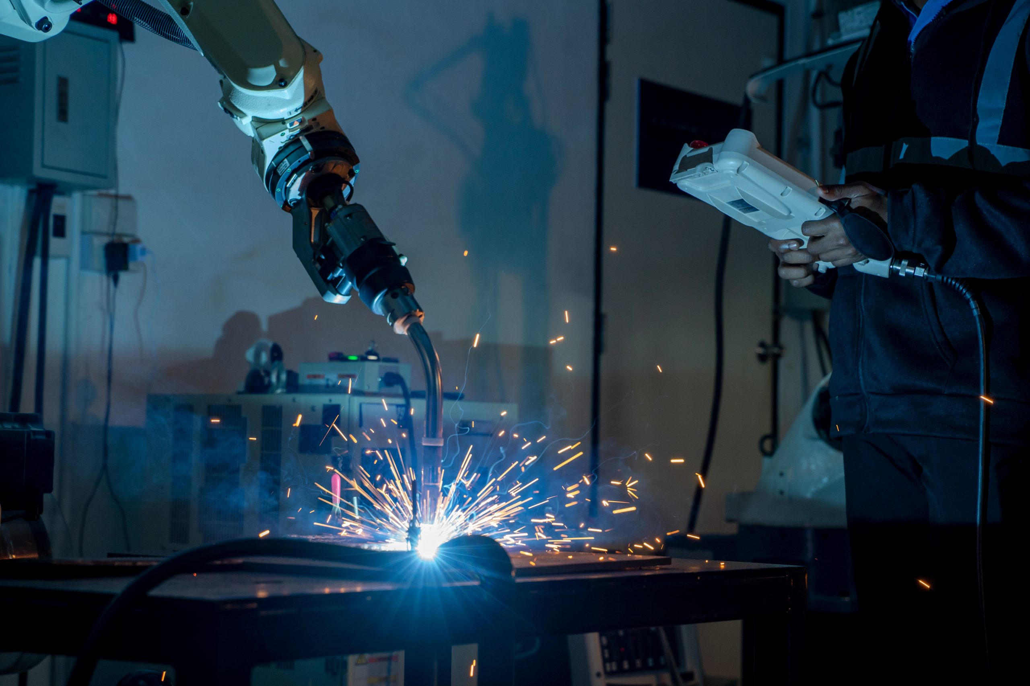
Introduction to MSC Simufact Welding 2024
MSC Simufact Welding is a numerical simulation software used to analyse welding processes and their thermal and mechanical effects.
CONCEPT
Real Welding
Process
IT HELPS STUDY:
▾
Heat transfer & temperature distribution
Thermal cycles
Residual stress
Distortion & deformation
Welding process behaviour
Represented as a
Numerical Model
▾
Solved via
Computational Methods
▾
Engineering
Results
Notes:
Now let's introduce the actual software we used — MSC Simufact Welding 2024. In simple terms, it is a numerical simulation tool used to study welding processes and their thermal and mechanical effects. It lets us study heat transfer and temperature distribution, thermal cycles, residual stress, distortion, and overall welding process behaviour. The basic idea, shown on the right, is that we take a real welding process and represent it as a numerical model, which is then solved using computational methods to produce engineering results like temperature and stress values. We will insert an actual screenshot of the software interface here once available.

Slide 6
Simulation Model & Input Parameters
1
Geometry
2
Material
3
Welding Parameters
Base dimensions – (100*100*10)mm³
Bead area – (30 *30) mm
Number of layers - 2
IN-718-sw
A nickel-based alloy
Current, voltage, welding speed
Heat-source efficiency
Deposition rate, layer height
Input | Purpose
Geometry | Defines the physical model
Material properties | Defines material behaviour
Heat source | Represents the welding heat
Welding speed | Controls heat-source movement
Boundary conditions | Represents real-world constraints
Mesh | Converts geometry into an FE model
Simulation Setup
Notes:
Before running any simulation, we need to feed the software specific input information. This falls into three broad categories: geometry, such as substrate size and number of layers; material properties, like density, thermal conductivity, and yield strength, ideally as functions of temperature; and welding parameters such as current, voltage, welding speed, and heat-source efficiency. The table at the bottom summarizes why each of these inputs matters — for example, the mesh is what converts our geometry into a finite element model that the solver can actually work with.

Slide 7
Simulation Workflow in MSC Simufact Welding 2024
1
4
7
Create / Import Geometry
Define Heat Source
Define Thermal Boundary Conditions
2
5
8
10
Define Material
Define Deposition / Welding Path
Define Mechanical Constraints
Post-Process Results
3
6
9
Generate Mesh
Define Process Parameters
Run Simulation
Simulation Setup
Notes:
This slide shows the complete simulation workflow we followed inside MSC Simufact Welding 2024. We start by creating or importing the geometry, then define the material, generate the mesh, and define the heat source. After that we set the deposition or welding path, the process parameters, the thermal boundary conditions, and the mechanical constraints. Once everything is defined, we run the simulation and finally post-process the results. Each of these ten steps builds on the previous one, so getting the early steps right — especially geometry and mesh — is important for accurate results later.

Slide 8
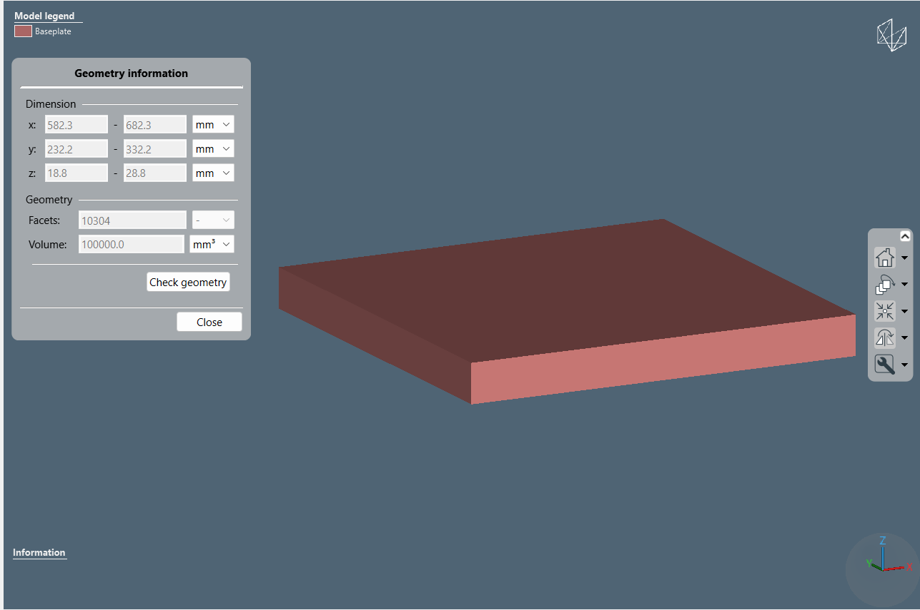
GEOMETRY
▦ INSERT GEOMETRY
SCREENSHOT

Slide 9
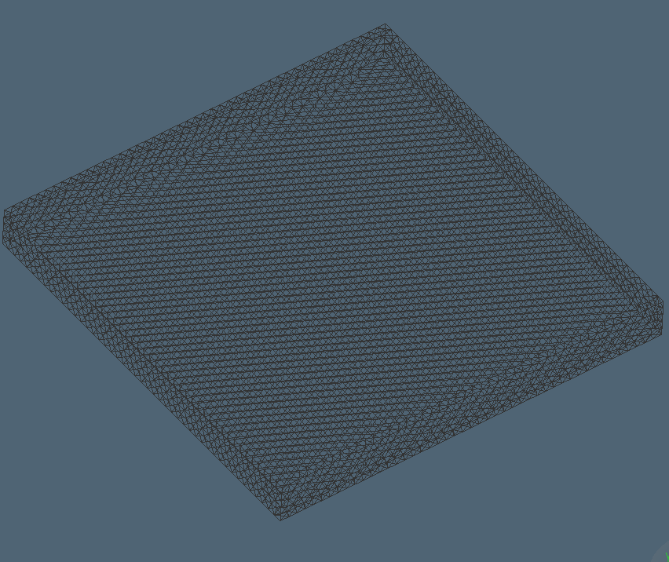
Meshing & Boundary Conditions
A. MESHING
B. BOUNDARY CONDITIONS
Geometry is divided into small finite elements
Finer mesh improves accuracy in high-temperature-gradient zones
Excessively fine mesh increases computational cost
Deposition / weld region generally needs careful mesh refinement
Initial temperature
Ambient temperature
Convection
Radiation
Thermal contact
Mechanical constraints
Clamping / restraints
▦ INSERT MESH IMAGE
FROM SIMUFACT
Notes:
This slide has two parts. First, meshing: the geometry is divided into small finite elements, and a finer mesh generally improves accuracy in regions with high temperature gradients, though it also increases computational cost, so the weld or deposition region usually needs focused mesh refinement rather than refining the whole part. Second, boundary conditions: these include the initial and ambient temperature, convection, radiation, thermal contact between parts, and mechanical constraints such as clamping. Realistic boundary conditions matter a lot because they directly influence how accurately the simulation predicts distortion and residual stress.

Slide 10
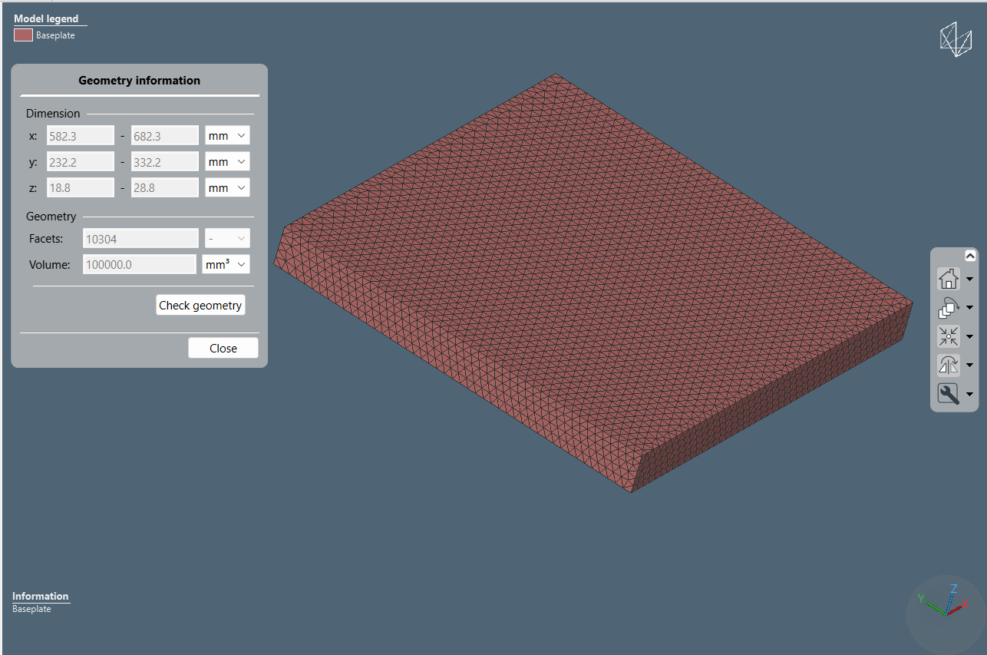
MESHING
▦ INSERT PROCESS/PATH
SCREENSHOT

Slide 11
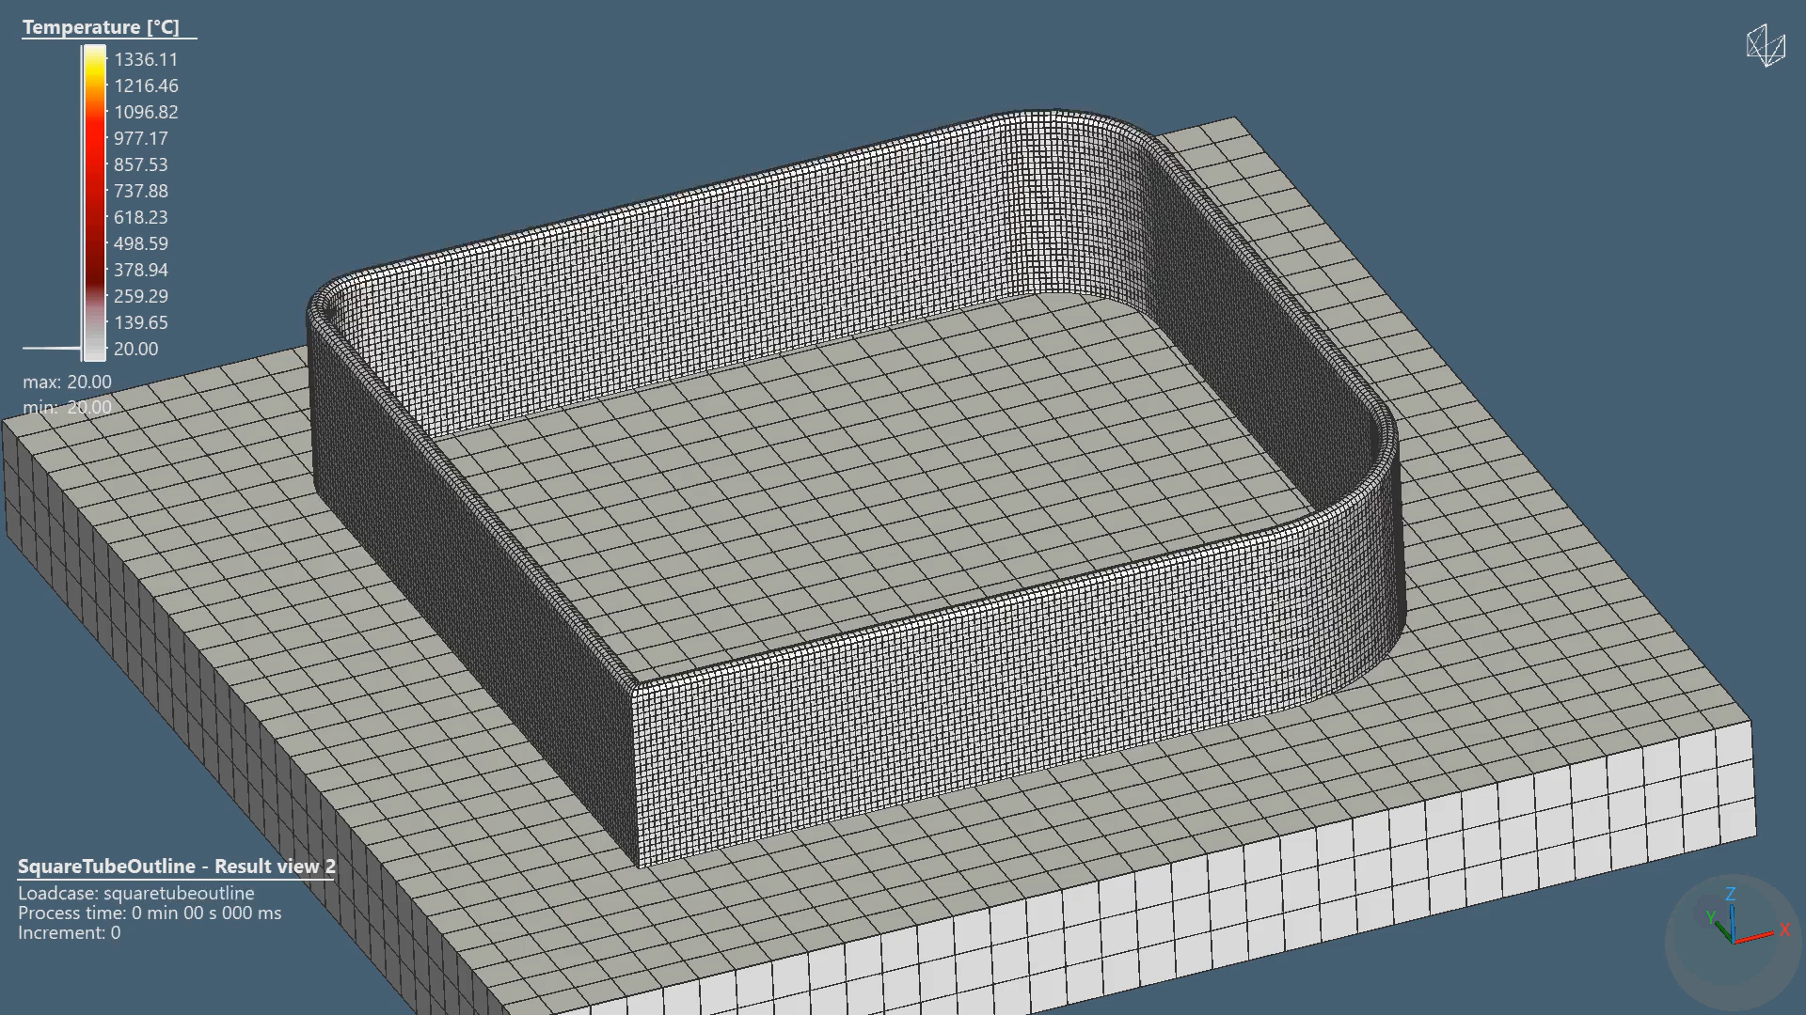
Thermal Simulation & Temperature Distribution
Heat source starts at the beginning of the path
Material temperature rises
A high-temperature / molten region develops
Heat conducts into surrounding material
Heat source moves forward
Previously heated material starts cooling
Subsequent layers can reheat previous layers
▦ INSERT ACTUAL SIMUFACT
TEMPERATURE CONTOUR
▦ INSERT ACTUAL TEMPERATURE
vs TIME GRAPH
Maximum Temperature = 1336.11 °C
Notes:
Now let's look at what actually happens thermally during the simulation. The heat source starts at the beginning of the path, the material temperature rises, and a molten region develops at the deposition zone. Heat then conducts into the surrounding material, the heat source keeps moving forward, and the material that was heated earlier begins to cool. When multiple layers are deposited, later layers can even reheat the layers below them. On the right we will insert our actual temperature contour and the maximum temperature recorded, along with a temperature-versus-time graph once our simulation results are available — we have not fabricated any values here.

Slide 12
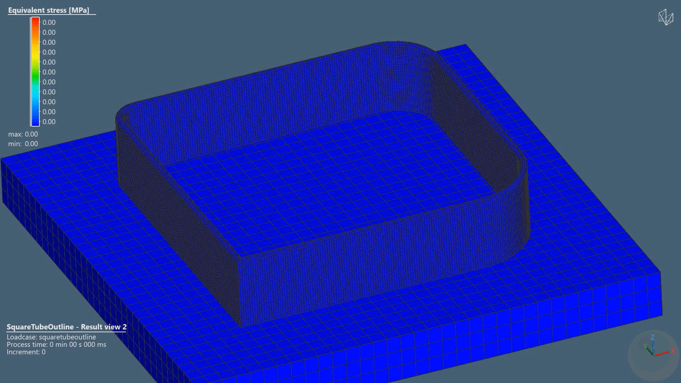
EQUIVALENT STRESS
Max Equivalent Stress = 1017.40 Mpa

Slide 13
Results & Discussion
Simulation Output | Actual Result | Interpretation
Maximum Temperature | 1336.11 °C | Peak thermal condition
Maximum Equivalent Stress | 1017.40 Mpa | Welding-induced stress
DISCUSSION
Highest temperature is expected near the moving heat source
Temperature decreases with distance from the deposition region
Repeated layers produce repeated thermal cycles
Non-uniform cooling contributes to residual stress
Thermal contraction contributes to distortion
18
Notes:
This table summarizes the key outputs we expect from our simulation — maximum temperature, maximum residual stress, maximum deformation, the cooling and heating cycle, and the final deposition geometry, along with what each one tells us physically. Below that, the discussion points are general trends we expect based on the physics of the process: the highest temperature occurs near the moving heat source, temperature falls off with distance, repeated layers create repeated thermal cycles, and non-uniform cooling drives both residual stress and distortion. We want to be clear that these are expected trends, and we will confirm them against our actual simulation output rather than presenting them as measured results.

Slide 14
Conclusion & Future Scope
CONCLUSION
FUTURE SCOPE
Deposition welding is useful for material addition, repair, cladding and additive manufacturing
The process involves complex heating, melting, deposition and cooling
MSC Simufact Welding 2024 enables numerical study of thermal & mechanical behaviour
Temperature distribution, residual stress and deformation are key simulation outputs
Simulation helps engineers understand and optimize the process before physical trials
Experimental validation of simulation results
Optimization of current, voltage and speed
Multi-layer deposition studies
Trials with different materials & heat-source models
Distortion control & microstructure prediction
Integration with additive manufacturing
THANK YOU
Gaurav Kumar — 2301089 • Sharansh — 2301090 • Akanksha Sharma — 2301093
Department of Mechanical Engineering, National Institute of Technology Patna
Conclusion
Notes:
To conclude: deposition welding is a valuable process for material addition, repair, cladding, and additive manufacturing, but it involves complex heating, melting, deposition, and cooling behaviour. MSC Simufact Welding 2024 allows us to numerically study the thermal and mechanical behaviour of this process, and outputs like temperature distribution, residual stress, and deformation help engineers optimize the process before running physical trials. Going forward, the natural next steps are experimental validation of our results, optimizing parameters like current, voltage, and speed, studying multi-layer deposition further, and eventually extending this work toward additive manufacturing. Thank you, and we're happy to take any questions.

